Slide 1

Institute of Technology
School of Computing
Department of Software Engineering
Fundamentals of Cloud computing
“Chapter 3 :Parallel and Distributed programming-Paradigms”
By Abebaw S.

Slide 2

Outline
Parallel Computing vs Distributed computing
MapReduce, Twister and Iterative MapReduce
Hadoop Library from Apache
Mapping Applications
Programming Support
Google App Engine,
Amazon AWS
Cloud Software Environments
Eucalyptus
Open nebula
OpenStack

Slide 3
Parallel Vs Distributed Computing
What is Parallel Computing ?
Parallel computing is a type of computing which multiple processors working together in one system to solve parts of a problem simultaneously
Often uses shared memory.
What is Distributed computing?
A system in which multiple independent systems (computers) connected via a network to work together.
Each systems has its own memory.

Slide 4
Parallel
Distributed
Use Multiple processors or cores in a single machine.
Processors access common memory
Communication happens via shared memory or IPC
Fault tolerance is limited; failure affects the entire system.
Scales by adding more processors to a single machine.
Examples: Multi-core processors, GPU computing.
Multiple-independent computers connected over a network.
Each computer has its own private memory.
Communication happens through message passing over a network
Fault tolerance is more complex and can handle individual machine failures.
Scales by adding more computers (nodes) to the system.
Examples: Cloud computing, Hadoop, distributed databases.

Slide 5
MapReduce
MapReduce is a programming model for processing large datasets in a parallel and distributed manner.
It achieves this by abstracting the complexities of data distribution, task scheduling, and fault tolerance from the developer.
The model consists of two main functions:
Map: Processes input data and produces intermediate key-value pairs.
Reduce: Groups the intermediate key-value pairs by key and applies a function to produce the final output.

Slide 6
MapReduce Data Flow
The data flow in a MapReduce job typically involves the following stages:
Input and Splitting: input data is divided into smaller chunks called "splits."
Mapping: The Map function is applied to each split in parallel by multiple map tasks.
Shuffling and Sorting: The intermediate key-value pairs generated by the map tasks are grouped by key and sorted.
Reducing: The Reduce function is applied to each grouped set of values for a given key by multiple reduce tasks.
Output: The output from the reduce tasks is written to the output destination

Slide 7
Cont’d …
Word Count Example
Input: A large text file containing words.
Map: Each map task counts the occurrences of each word in its assigned data split, emitting pairs like (word, count). For example, if a split contains "apple apple banana," the map output would be: (apple, 2), (banana, 1).
Shuffle: The MapReduce framework groups intermediate pairs with the same key (word) together.
Reduce: Reduce tasks receive groups like (apple, [2, 1, 1...]) and sum the counts for each word, producing the final
Output: (apple, 4).

Slide 8
Why MapReduce?
Scalability:
MapReduce designed to handle datasets that are too large to be processed on a single machine.
By dividing the data and computation across multiple machines.
It achieves scalability and can process petabytes of data using thousands of nodes.
Fault Tolerance:
In distributed systems like those found in cloud environments, hardware failures are common.
MapReduce is naturally fault-tolerant, as it has the ability to re-run failed tasks on other available nodes.

Slide 9
Cont’d…
Simplified Programming Model:
MapReduce provides a high-level abstraction that hides the complexities of distributed computing from developers
Programmers only focuses on defining the map and reduce functions without having to handle the complexities of data distribution, task scheduling, or fault tolerance.

Slide 10
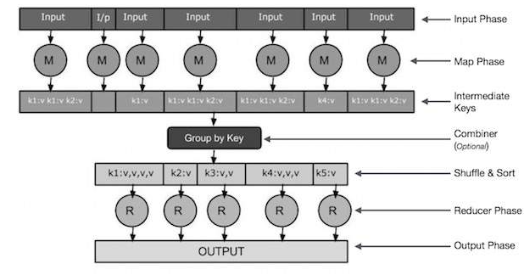
How MapReduce Works? With examples

Slide 11
With examples . . .
Input and Splitting:
Imagine you have a large text file containing a collection of documents, and your goal is to count the occurrences of each word
The MapReduce framework first splits this input file into smaller chunks called input splits
For example, if your file is 1GB and you're using a cluster with 10 nodes, you might split it into 100MB chunks.
Each input split is then assigned to a map task for processing.

Slide 12
With examples . . .
Splitting: Word Count
Input File:
"This is a sample document. It contains some words."
"We will count the occurrences of each word."
Input Splits:
Split 1: "This is a sample document. It contains some words."
Split 2: "We will count the occurrences of each word."

Slide 13
With examples . . .
Mapping:
Each Map Function receives an input split and applies the user-defined map function to each element (typically a line) in the split.
The map function generates key-value pairs, with the key typically representing the item of interest and the value containing some related information.
Intermediate keys
Are the output generated by the map phase (key, value) pairs.
They are not the final result but are used in the next phase to perform sorting, grouping, and aggregation.

Slide 14
With examples . . .
Mapping: Word Count Example
Split 1: "This is a sample document. It contains some words."
Map Function Output:
("This", 1)
("is", 1)
("a", 1)
("sample", 1)
("document", 1)
("It", 1)
("contains", 1)
("some", 1)
("words", 1)

Slide 15
With examples . . .
Mapping: Word Count Example
Split 2: "We will count the occurrences of each word."
Map Function Output:
("We", 1)
("will", 1)
("count", 1)
("the", 1)
("occurrences", 1)
("of", 1)
("each", 1)
("word", 1)

Slide 16
With examples . . .
Shuffling and Sorting:
The MapReduce framework collects all the key-value pairs produced by the map function and rearranges them, grouping pairs with the same key together.
Within each group, the values are then sorted. This ensures that all values associated with a particular key are sent to the same "reduce" task.
Shuffling and Sorting: Word Count Example
You can see the Shuffled and Sorted Output in the next slide

Slide 17
With examples . . .
("This", [1])
("a", [1])
("contains", [1])
("count", [1])
("document", [1])
("each", [1])
("is", [1])
("It", [1])
("occurrences", [1])
("of", [1])
("sample", [1])
("some", [1])
("the", [1])
("We", [1])
("will", [1])
("word", [2]) // "word" has two occurrences
("words", [1])

Slide 18
With examples . . .
Reducing:
Each reduce task receives a group of key-value pairs with the same key.
It applies the user-defined "reduce" function to this group, combining the values to produce a final output.
Reducing: Word Count Example
Input to Reducer: ("word", [1, 1])
Reduce Function Output: ("word", 2)

Slide 19
With examples . . .
Output:
The final outputs from all the reduce tasks are collected and written to the output destination, which could be a file or a database.
Output: Word Count Example
Output File:
("This", 1)
("a", 1)
("contains", 1)
("count", 1)
// ... other words and counts ...
("word", 2)
("words", 1)

Slide 20
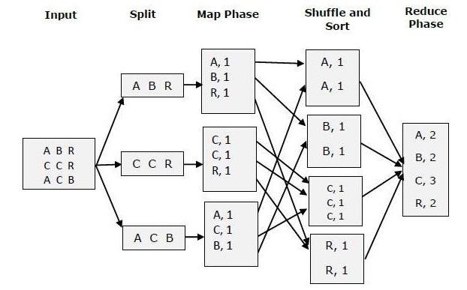

Slide 21
Iterative MapReduce
Iterative MapReduce is a computational technique that involves repeatedly applying the MapReduce programming model to solve problems that require multiple iterations.
Many algorithms in fields like data clustering, machine learning, and computer vision require iterative computations.
Iterative MapReduce extends the basic MapReduce model to handle these iterative algorithms efficiently.

Slide 22
Motivation in Iterative MapReduce
Traditional MapReduce implementations like Apache Hadoop, while successful for single-step computations, encounter several inefficiencies.
High I/O Costs:
Relies heavily on disk I/O for storing intermediate data after each iteration.
This frequent disk access significantly impacts performance.
Task Initialization Overhead:
Frameworks like Hadoop recreate map and reduce tasks for every iteration.
This leads considerable overhead during task initialization and data loading.

Slide 23
Cont’d…
Limited Communication Mechanisms:
Traditional MapReduce often relies on file-based communication between map and reduce stages.
This approach is less efficient than in-memory data transfer methods, as it involves the additional overhead of serialization, deserialization, and disk access.
Lack of Support for Static and Variable Data:
Static data remains constant across iterations
variable data updated in each iteration.
This lack of distinction leads to inefficiencies, as static data is repeatedly loaded and processed even though it remains unchanged.

Slide 24
Cont’d…
Inefficient for Algorithms with Complex Communication Patterns:
Traditional MapReduce is highly effective in applications with simple data flow patterns.
However, algorithms that need more complex communication structures, like those involving all-to-all communication, can be difficult.
Iterative MapReduce tackles these limitations by extending the MapReduce model with features designed for iterative processing.

Slide 25
Steps in Iterative MapReduce
Initialization:
The input data is loaded
Initial values are set for any variables that will be updated iteratively.
Iteration:
A series of MapReduce jobs are executed in a loop.
Each iteration takes the output of the previous iteration as input and produces a new set of output.

Slide 26
Steps in Iterative MapReduce
Convergence Check:
After each iteration, a convergence check is performed to determine whether the algorithm has reached a solution.
This check could involve comparing the current output to the previous output or evaluating some other convergence criterion.
Termination:
The iterations continue until the convergence criterion is met or a maximum number of iterations is reached.
The final output is then produced.

Slide 27
Iterative MapReduce: K-Means Clustering
K-Means aims to partition a set of data points into k clusters.
Here's how it can be implemented using Iterative MapReduce:
Initialization
Randomly select k data points as initial cluster centers.
Load the data points into the distributed file system.
Iteration
Map:
calculate the distance to each cluster center.
Assign the data point to the cluster with the nearest center.
Generate key-value pairs where the key represents the cluster ID and the value corresponds to the data point.

Slide 28
Cont’d …
Reduce:
For each cluster ID, calculate the mean of all data points assigned to that cluster.
Update the cluster center to be the new mean
Convergence Check:
Calculate the distance between the new cluster centers and the previous cluster centers.
If the distance is below a threshold, the algorithm has converged.
Termination:
Repeat steps 2 and 3 until convergence or a maximum number of iterations is reached.
The final cluster centers define the k clusters.

Slide 29
Iterative MapReduce: Twister
Twister is an enhanced MapReduce runtime designed specifically for iterative computations.
It introduces several features that improve the performance of iterative algorithms.
Distinguishes between static and variable date :
static data: unchanged throughout iterations
variable data updated in each iteration).
This allows for efficient data handling.
Long-Running Map/Reduce Tasks:
Eliminating the overhead of repeatedly loading static data

Slide 30
Iterative MapReduce: Twister
Combine Operation:
Includes combine phase to aggregate the outputs of reduce tasks, and to determine whether to proceed with iteration or not.
Benefits of Iterative MapReduce:
Scalability: Can handle massive datasets by distributing computations across a cluster of machines.
Fault Tolerance: Can recover from failures of individual machines without losing progress.
Applicability: Suitable for a wide range of iterative algorithms in various domains.

Slide 31
Hadoop Library
Hadoop is an open-source software framework written in Java
It used to implements the MapReduce programming model
The purpose is processing vast amounts of data in a distributed computing environment. It consists of two fundamental layers:
MapReduce Engine
Built on top of HDFS
It manages the data flow and control flow of MapReduce jobs over distributed computing systems.
Like HDFS has a master/slave architecture consisting of a single JobTracker as the master and a number of TaskTrackers as the slaves (workers).
JobTracker manages the MapReduce job over a cluster and is responsible for monitoring jobs and assigning tasks to TaskTrackers.

Slide 32
Hadoop Library
The TaskTracker manages the execution of the map and/or reduce tasks on a single computation node in the cluster.
Each TaskTracker node has a number of simultaneous execution slots, each executing either a map or a reduce task.
Slots are defined as the number of simultaneous threads supported by CPUs of the TaskTracker node.
For example, a TaskTracker node with N CPUs, each supporting M threads, has M * N simultaneous execution slots

Slide 33
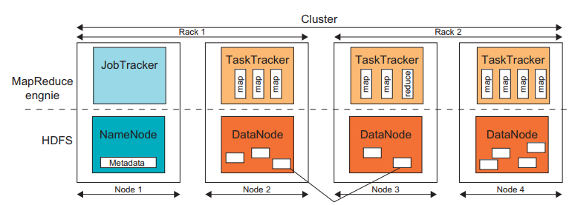
Hadoop Library

Slide 34
Hadoop Library
Each data block is processed by one map task running on a single slot.
Therefore, there is a one-to-one correspondence
between map tasks in a TaskTracker and data blocks in the respective DataNode.
HDFS:
It is a distributed file system inspired by GFS
It organizes files and stores their data on a distributed computing system.
It divides files into fixed-size blocks, typically 64MB, and replicates them on multiple DataNodes for fault tolerance

Slide 35
Mapping applications
Mapping applications involves strategically distributing the workload and data across multiple processing units to improve performance and efficiency.
This process considers the application's characteristics, resource availability, and suitable programming models.
Image Processing:
Pleasingly parallel: Different portions of an image can be processed independently.
Partitioning: Divide the image into smaller blocks.
Mapping: Assign each block to a separate processing unit.

Slide 36
Mapping applications
Particle Interactions:
Loosely synchronous: Requires periodic communication between units to exchange data on particle positions and interactions.
Partitioning: Divide the simulation space into subdomains.
Mapping: Assign each subdomain to a processing unit, ensuring neighboring units can exchange boundary data.
Large-Scale Data Analysis:
Data-intensive: processing massive datasets, often using the MapReduce paradigm.
Partitioning: Split the dataset into smaller chunks.
Mapping: In MapReduce, the framework handles the mapping of map and reduce tasks to processing units based on data locality.

Slide 37
Cont’d…
Data Locality:
Place computations close to their data to minimize data transfer time.
Load Balancing:
Distribute tasks evenly to avoid bottlenecks.
Communication Optimization:
Reduce communication overhead by aligning mapping with communication patterns.

Slide 38
Programming Support of Google App Engine
Google App Engine (GAE) is a platform for building and deploying web applications.
GAE provides a complete development environment with SDKs, a runtime environment, and an administration console.
Developers can use Python, Java, or Go PLs.
GAE offers a data storage service (Datastore) based on Google's BigTable technology.
It can store structured data and perform queries.
Memcache provides in-memory caching for improved performance.

Slide 39
Cont’d…
Some features offered by GAE are:
User authentication: Authenticate users via Google Accounts.
Image Manipulation: Handles image manipulation tasks.
Scheduled Tasks: Developers can schedule background tasks and periodic jobs using cron jobs
URL fetch: Allows applications to retrieve data from external websites.
Mail: Applications can use GAE's mail service to send email messages

Slide 40
Cont’d…
AWS offers robust programming support to help developers build and deploy applications.
AWS provides a comprehensive set of tools and resources, empowering developers to build diverse applications.
(SDKs)
SDKs:
AWS provides SDKs for a variety of PLs, such as Java, Python, .NET, and more.
These SDKs offer convenient libraries and APIs, to simplifying interactions with AWS services.
The SDKs abstract the complexities of making low-level API calls, enabling developers to focus on application logic.

Slide 41
Cont’d…
CLI:
The AWS CLI allows developers to manage and interact with AWS services directly from their command line.
This tool provides a text-based interface for performing a wide range of tasks, including launching EC2 instances, managing S3 buckets, and configuring other AWS services.
AWS Management Console:
The AWS Management Console offers a web-based visual interface for managing AWS resources and services.
This console provides a user-friendly way to monitor and control various aspects of AWS, including EC2 instances, S3 storage, IAM users and permissions, and much more.

Slide 42
Cont’d…
Infrastructure as Code (IaC) Tools
AWS supports Infrastructure as Code (IaC) tools such as AWS CloudFormation and Terraform.
These tools enable developers to define and manage their infrastructure using code, promoting automation and reproducibility.
IaC simplifies infrastructure provisioning, configuration management, and deployment.
Programming Models
MapReduce:
AWS supports the MapReduce programming model through its Elastic MapReduce (EMR) service.
EMR allows users to process vast amounts of data using a managed Hadoop cluster.

Slide 43
Cont’d…
Several languages, including Hive, Pig, Cascading, Java, Ruby, Perl, Python, PHP, R, and C++, are supported for EMR programming
Serverless Computing:
AWS Lambda enables serverless computing, allowing developers to run code without provisioning or managing servers.
Lambda functions can be triggered by various events, such as changes in S3 buckets or API requests.
Specific Service APIs
Amazon EC2: Provides APIs for managing EC2 instances, including launching, terminating, and monitoring instances.

Slide 44
Cont’d…
Amazon S3: Offers APIs for storing and retrieving objects in S3 buckets, managing access control, and performing other S3 operations.
Amazon SimpleDB: Supports a simple query language for interacting with SimpleDB, enabling data storage and retrieval.
Amazon SQS: Includes APIs for sending, receiving, and managing messages in SQS queues.
Documentation and Support
AWS provides comprehensive documentation, including tutorials, guides, and API references.
AWS also offers various support channels, including online forums, developer communities, and paid support options.

Slide 45
Cloud Software Environments
Cloud software environments are specialized software that provide the foundation for building and managing cloud computing infrastructures.
They allow organizations to create private, public, or hybrid clouds, enabling them to offer various cloud services, such as IaaS, PaaS, or SaaS.
In this session will explain the three popular open-source cloud software environments: Eucalyptus, OpenNebula, and OpenStack

Slide 46
Eucalyptus
Eucalyptus is designed primarily to support IaaS clouds.
It focus on virtual networking and management of VMs.
It was developed by Eucalyptus Systems, originating from a research project at the University of California, Santa Barbara.
It was designed to provide services compatible with Amazon’s EC2 cloud and Simple Storage Service(S3)
It offers services like Walrus, a block storage system similar to Amazon S3.
Eucalyptus used to build private clouds that interact with end-users through Ethernet or the Internet and can also interact with other private or public clouds.

Slide 47
Cont’d…
Eucalyptus is designed primarily to support IaaS clouds.
It focus on virtual networking and management of VMs.
It was developed by Eucalyptus Systems, originating from a research project at the University of California, Santa Barbara.
It was designed to provide services compatible with Amazon’s EC2 cloud and Simple Storage Service(S3)
It offers services like Walrus, a block storage system similar to Amazon S3.
Eucalyptus used to build private clouds that interact with end-users through Ethernet or the Internet and can also interact with other private or public clouds.

Slide 48
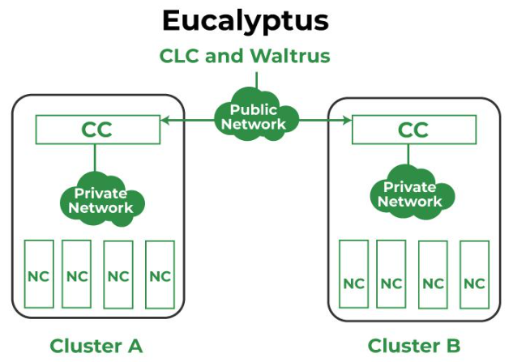
Cont’d…
Controller : CC - Cluster , CLC - Cloud, NC - Node

Slide 49
Cont’d…
Eucalyptus's image management system allows users to:
Bundle their own root file systems.
Upload and register images, linking them with specific kernel and RAM disk images.
Store images in Walrus, retrieving them from any availability zone.
This allows users to create and deploy specialized virtual appliances.
Eucalyptus is available in both commercial and open-source versions.

Slide 50
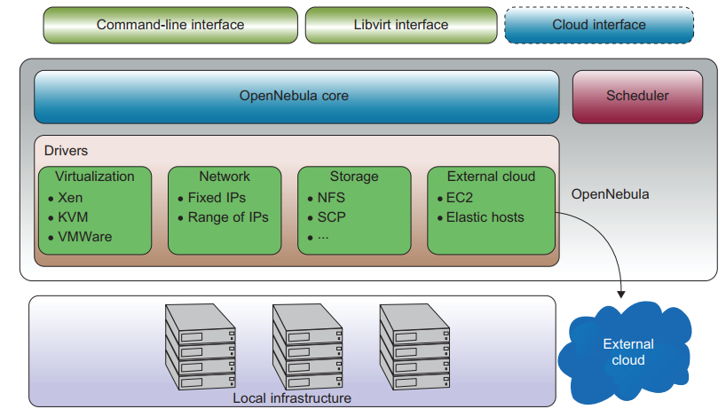
OpenNebula
It is a versatile open-source toolkit that transforms existing infrastructure into an IaaS cloud with cloud-like interfaces.

Slide 51
Cont’d…
Fig. in the previous slide shows the OpenNebula architecture and its main components.
It provides a flexible and modular architecture for integrating diverse storage, network infrastructure, and hypervisor technologies.
It manages the entire VM lifecycle, including dynamic network setup for groups of VMs and storage management.
A key strength is its ability to support hybrid cloud models.
OpenNebula can interface with external clouds (like Amazon EC2 and Eucalyptus) via cloud drivers.

Slide 52
OpenStack
OpenStack is a collaborative project introduced by Rackspace and NASA in July 2010.
It used for building massively scalable and secure open-source cloud infrastructure.
Focus on compute and storage through OpenStack Compute and OpenStack Storage solutions.
OpenStack Compute: manages large groups of virtual private servers.
OpenStack Storage: provides redundant and scalable object storage using clusters of commodity servers.

Slide 53
Thank you!

